Slide 1

Effects of Music on Mental Health: Exploratory Data Analysis
By Sarah Chauvin, Elizabeth Viramontes, Gabriela Zarate, and Tony

Slide 2
Intros
People
Data from a computer science student researching music therapy
Uncommon genre definitions
EDM: electronic dance music
R&B: rhythm and blues, subset of jazz
K pop: Korean popular music
Gospel: religious music
Lofi: low fidelity, or imperfect sound, mix of hip hop, jazz, and soul

Slide 3
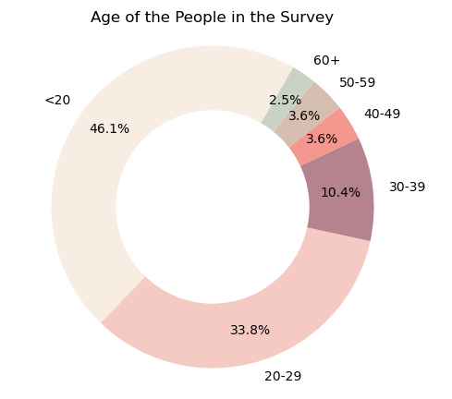
Mental health disorders included in survey: Anxiety, Depression, Insomnia, & OCD

Slide 4
Data Cleaning

Slide 5
Are there significant differences in mental health rankings based on age groups for those who frequently listen to specific genres?
Distribution of illness by age
Under 40 y/o = bad mental health (OCD limited)
Illness level by fav genre and age
Highest mental illness (not OCD) with Rock, Pop, Metal, Hip hop

Slide 6
Does the frequency of listening to different genres correlate with different mental health disorders?
Highest mental illness in listeners of Rock and Pop by frequency, but favorites are Rock, Pop, and Metal
BPM is hardly related to disorder

Slide 7
Music effects vs fav genre
Genres with best effects:
Listening time vs improvement
Best listening time for mental health: 4-5 hours/day

Slide 8
Regression

Slide 9
Conclusion

Slide 10
Limitations Future Study
1x survey, no trends over time
Subjective data, no parameters on how to rank mental health. Hard to establish relationships
Source of BPM: Most common? Highest?
This section was optional
Data largely came from the internet
Music effects
Improvement based on certain genres? Hours listened?
Which disorder(s) improved?
Occupation of survey respondent could influence hour listened/day
Concentrated results to a specific geographic location: compare to actual mental health stats
Including gender of respondent: more to compare

Slide 11
Works Cited
Kaggle dataset: Music & Mental Health Survey Results (kaggle.com)
Obsessive-Compulsive Disorder (OCD) - Psychiatric Disorders - Merck Manual Professional Edition (merckmanuals.com)
Basic information regarding different music genres and mental health disorders: Wikipedia.com
Matplotlib.org documentation
Xpert learning AI
Coolors.co

